Slide 1
E-Commerce Product Showcase
CAPSTONE PROJECT
Presented By:
NALLAM HARINI
Malla Reddy University-CSE(AIML)

Slide 2
OUTLINE
Problem Statement (Should not include solution)
System Development Approach (Technology Used)
Algorithm & Deployment (Step by Step Procedure)
Result
Conclusion
Future Scope(Optional)
References

Slide 3
Problem Statement
Many small businesses face significant barriers when attempting to establish an online presence for their products. Current e-commerce platforms are frequently designed with enterprise-scale complexity, resulting in steep learning curves, high maintenance requirements, and elevated subscription or transaction costs. For small business owners with limited technical expertise and tight budgets, these solutions are often impractical and unsustainable.
This gap in the market leaves small businesses at a disadvantage, unable to effectively showcase their products online or meet growing customer expectations for simple, engaging digital experiences. As consumer demand for convenient browsing, filtering, and detailed product exploration continues to rise, these businesses risk being excluded from the digital economy, limiting both their growth potential and overall competitiveness.

Slide 4
System Approach
Frontend Technologies:
HTML5 → Provides the semantic structure of the product showcase, categories, and modals.
CSS3 → Creates a responsive, mobile-first design using Flexbox & Grid, with gradients, animations, and hover effects for a polished UI.
JavaScript → Enables all dynamic interactions:
i)Product search & filtering.
ii)Cart, wishlist, and order management.
iii)Interactive modals for product details & checkout.
Design Approach:
Lightweight, visually appealing product showcase.
Simple upload & management → no technical expertise needed.
Smooth customer experience → browse, filter, view details easily.
Built-in engagement tools → wishlist, cart, quick checkout.

Slide 5
Algorithm & Deployment
1.Product Catalog Creation
A product catalog organizes items into categories (Clothing, Electronics, Home Décor, etc.). Each product should contain details like an image, price, and description. This structure makes it easier to display and manage products dynamically.
2.Frontend Design
The frontend should present products in a clean layout. Using CSS Grid allows products to adapt to different screen sizes (desktop, tablet, mobile). Each product is shown as a card with an image, title, description, and buttons.
3. Interactive Features
E-commerce sites need interactivity.
Add-to-Cart, Remove-from-Cart functions in JavaScript.
Real-time total price calculation.
Product filtering by category.
Modal views for product details.

Slide 6
Algorithm & Deployment
4.Testing:
Testing is an essential step in any web project because it ensures that the application works correctly for all users regardless of the device, browser, or environment. For this e-commerce product catalog, testing focuses on three main areas:
i. Cross-Browser Compatibility
Different browsers (Chrome, Firefox, Edge, Safari) render HTML, CSS, and JavaScript slightly differently.Test the website on at least three popular browsers to confirm that:
Layouts appear consistently.
Interactive features (Add-to-Cart, Remove-from-Cart, Modal popups) function without errors.
Styling (fonts, colors, borders) looks the same or very close.
ii. Functional Testing
Focuses on whether each feature works as intended. For this project:
Add-to-Cart: Check that clicking the button increases cart count and updates total price.
Remove-from-Cart: Ensure products can be removed and total recalculates correctly.

Slide 7
Algorithm & Deployment
Total Price Calculation: Verify that the sum updates in real time as items are added/removed.
Product Filtering: Switching categories should correctly show/hide products.
Modal Product Details: Clicking a product should display the correct details in a popup window.
5.Deployment Once development and testing are complete, the final step is to make the e-commerce project accessible to users on the internet. Since this project is built with HTML, CSS, and JavaScript only (no backend server required), it can be hosted for free on platforms like GitHub Pages or Netlify.

Slide 8
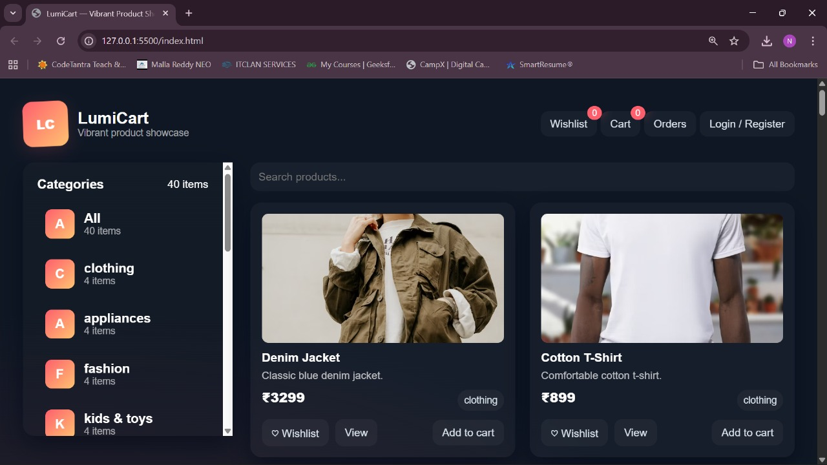
Result
HOME PAGE

Slide 9
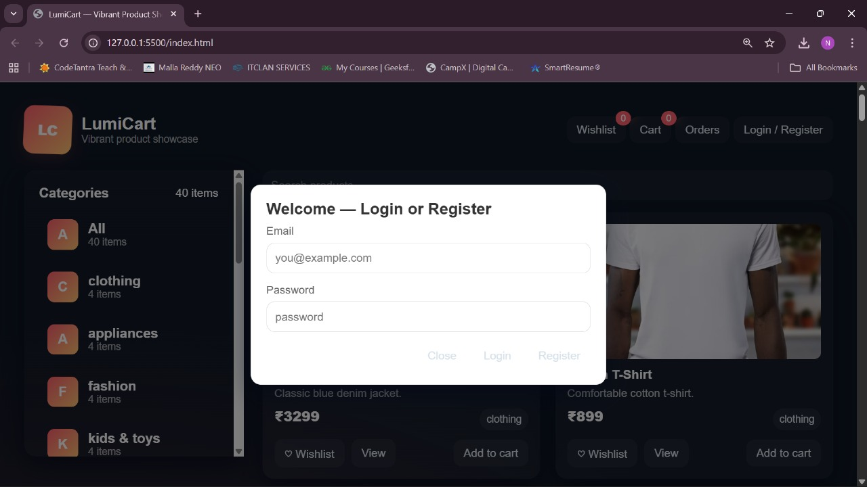
LOGIN/REGISTER

Slide 10
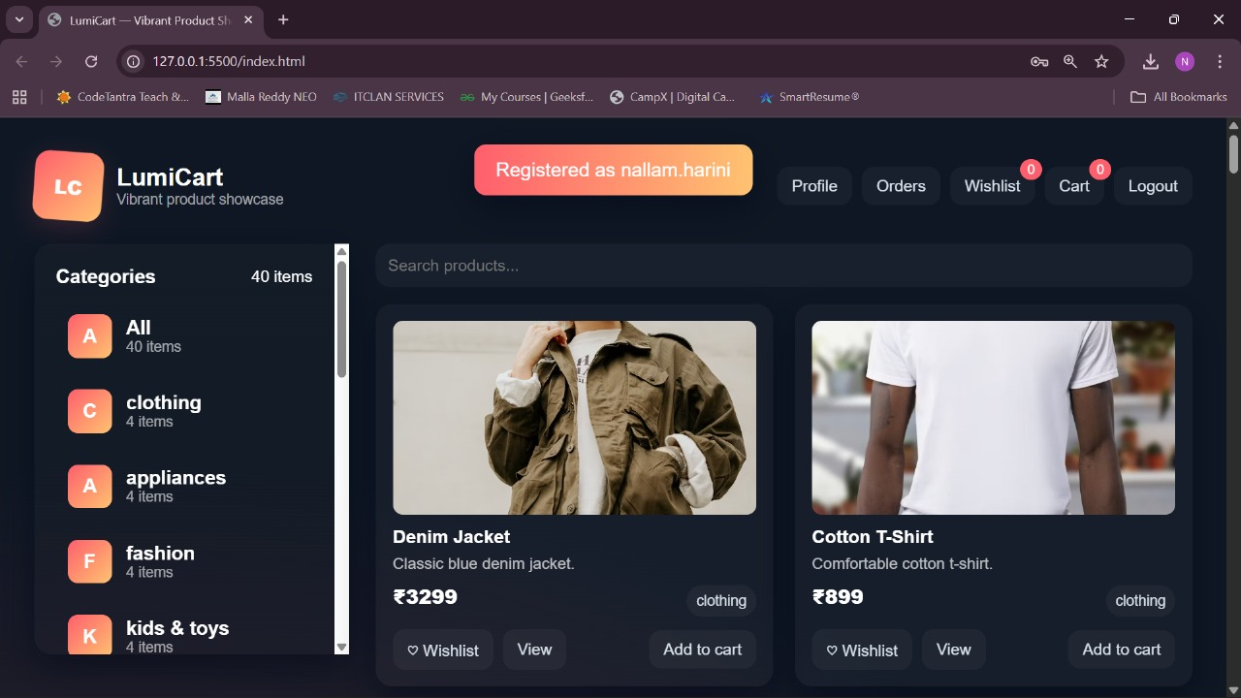
REGISTRATION:

Slide 11
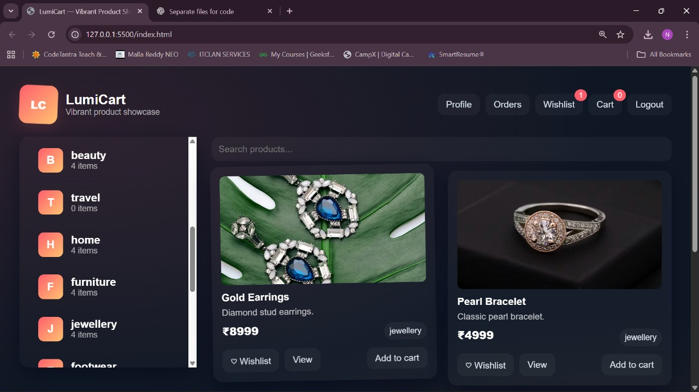
Product show case:

Slide 12
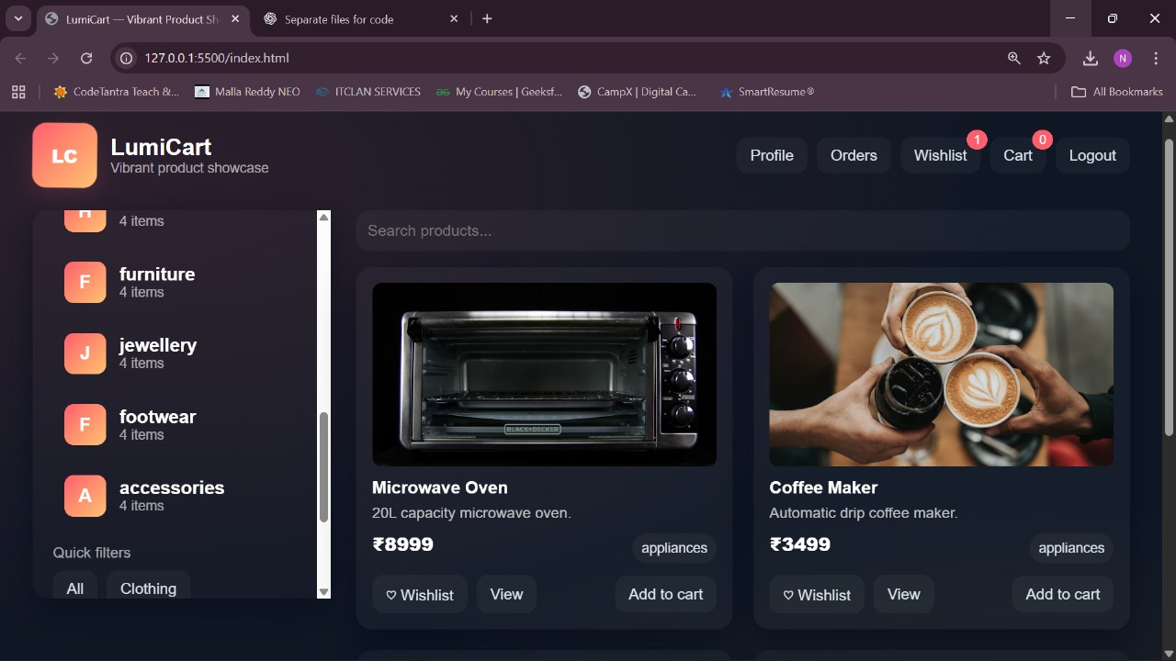
Product show case

Slide 13
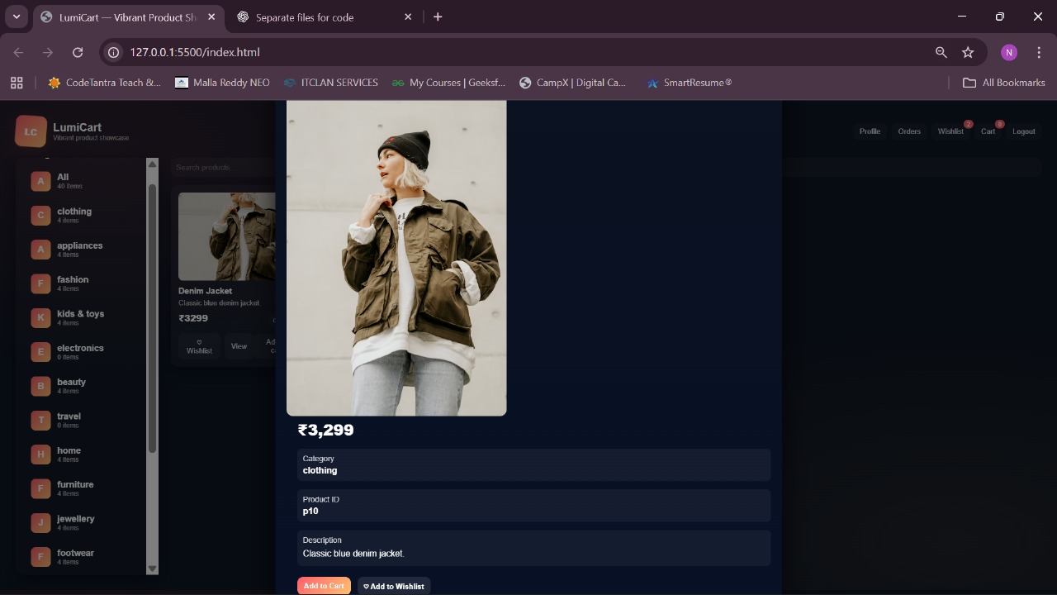
View the product:

Slide 14
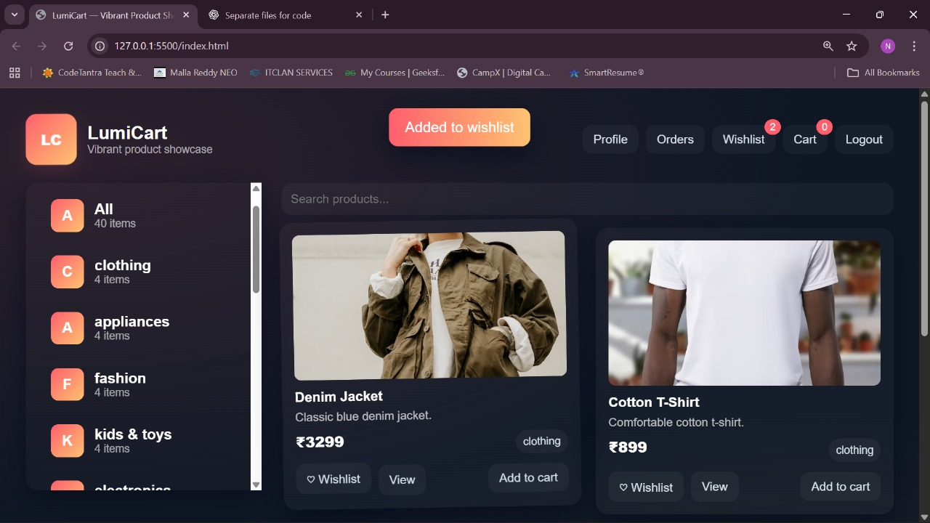
Product added to wishlist:

Slide 15
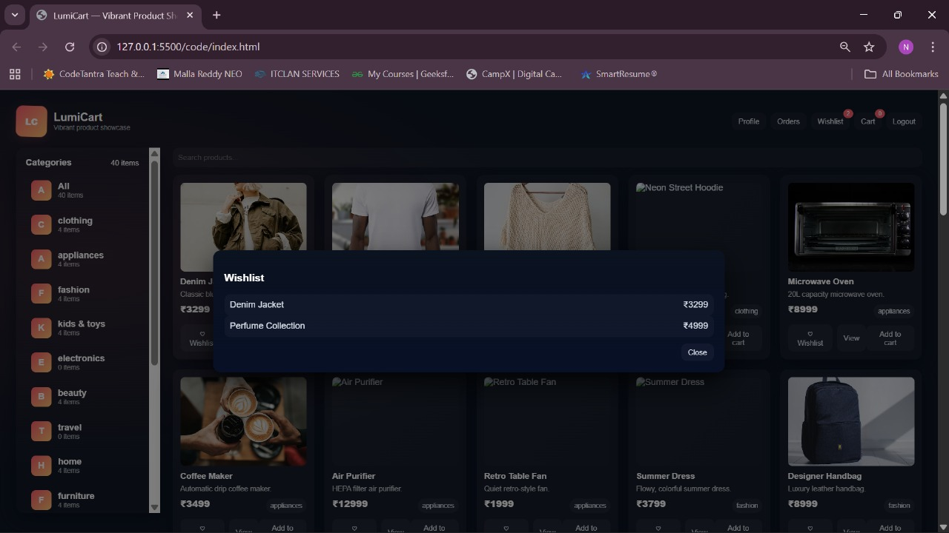
Wishlist view:

Slide 16
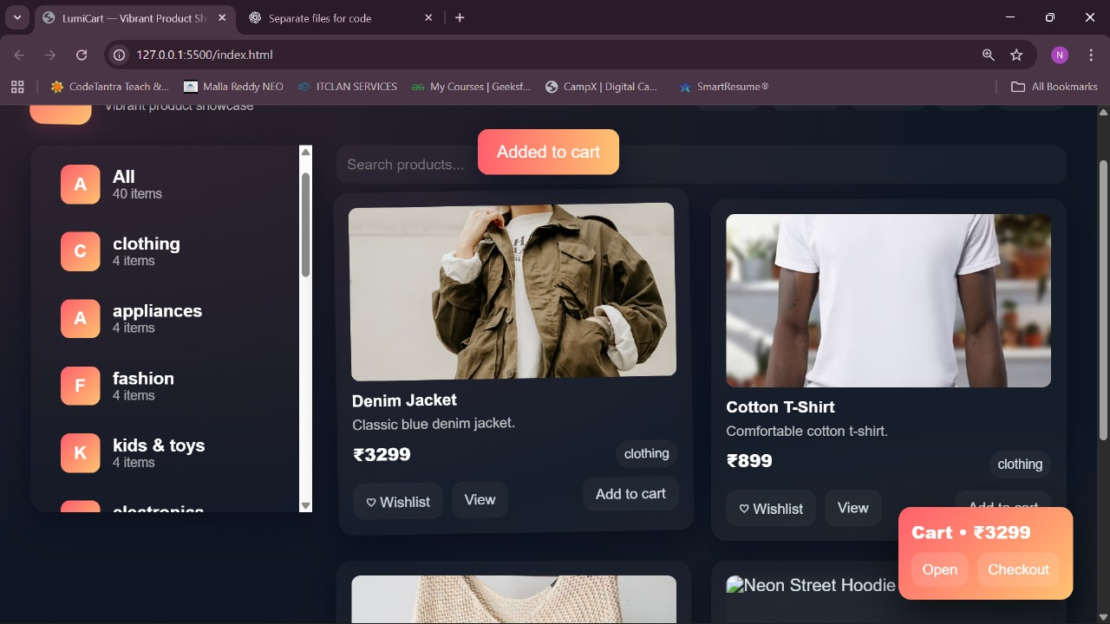
Product added to cart:

Slide 17
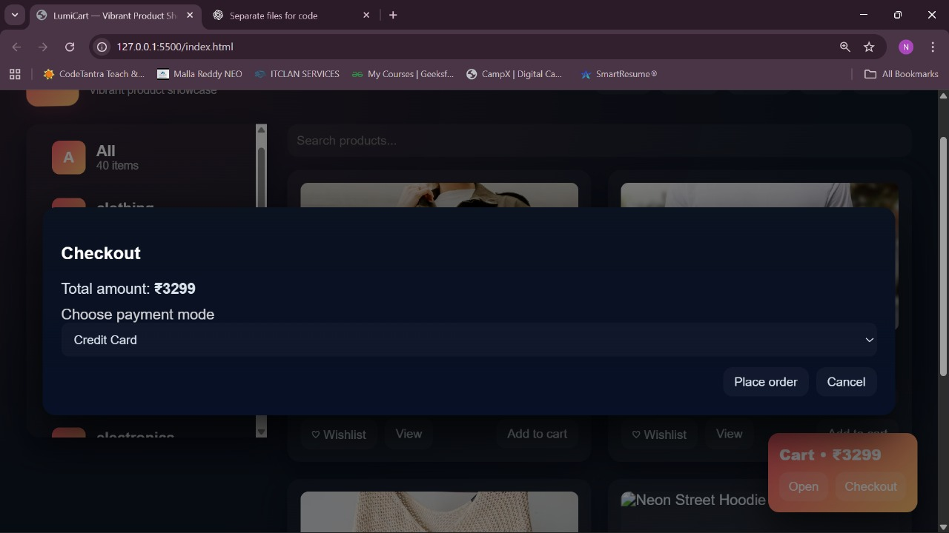
Payment page:

Slide 18
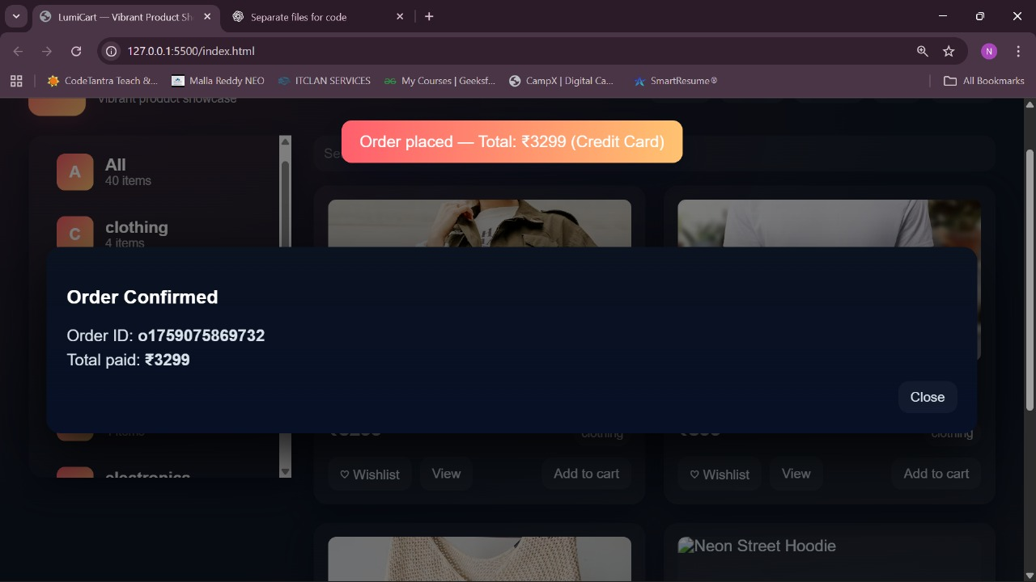
Order page:

Slide 19
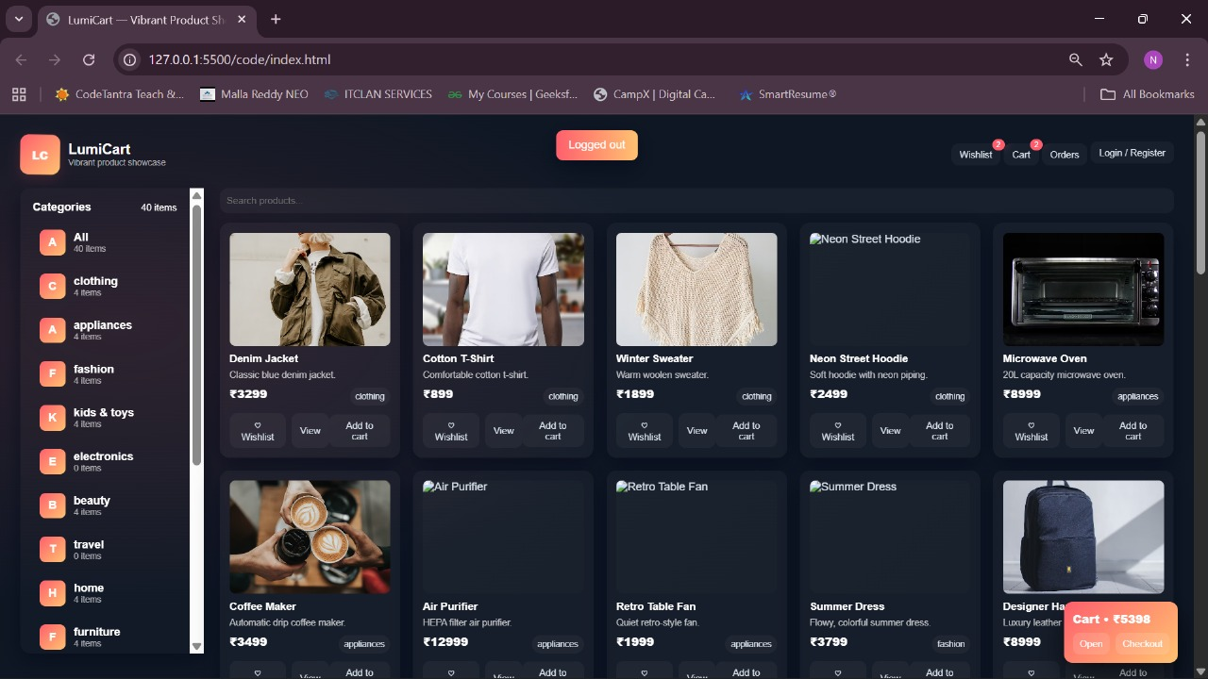
Logout:

Slide 20
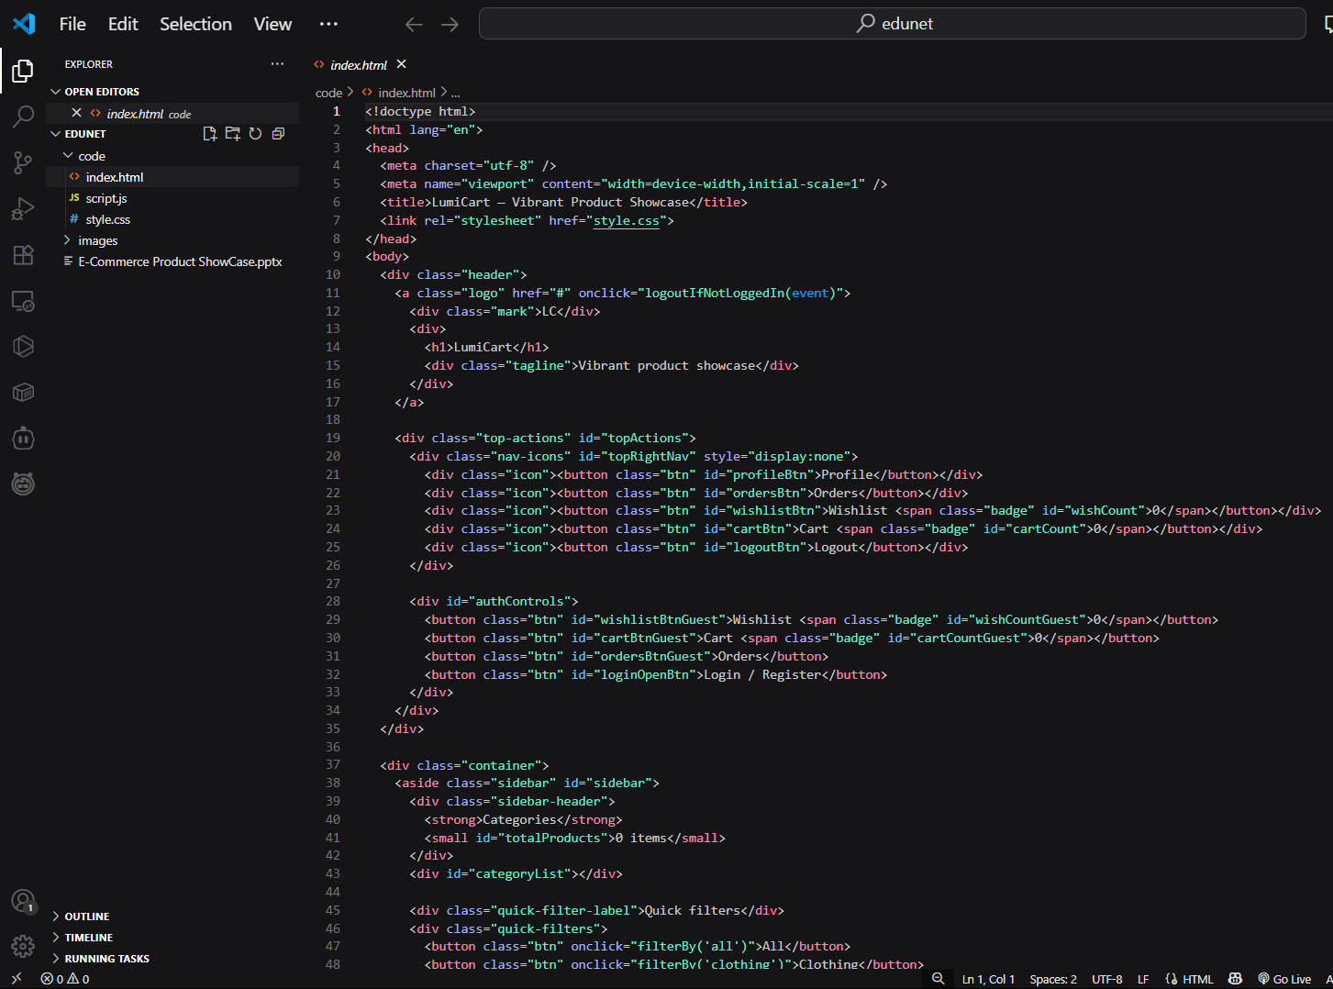
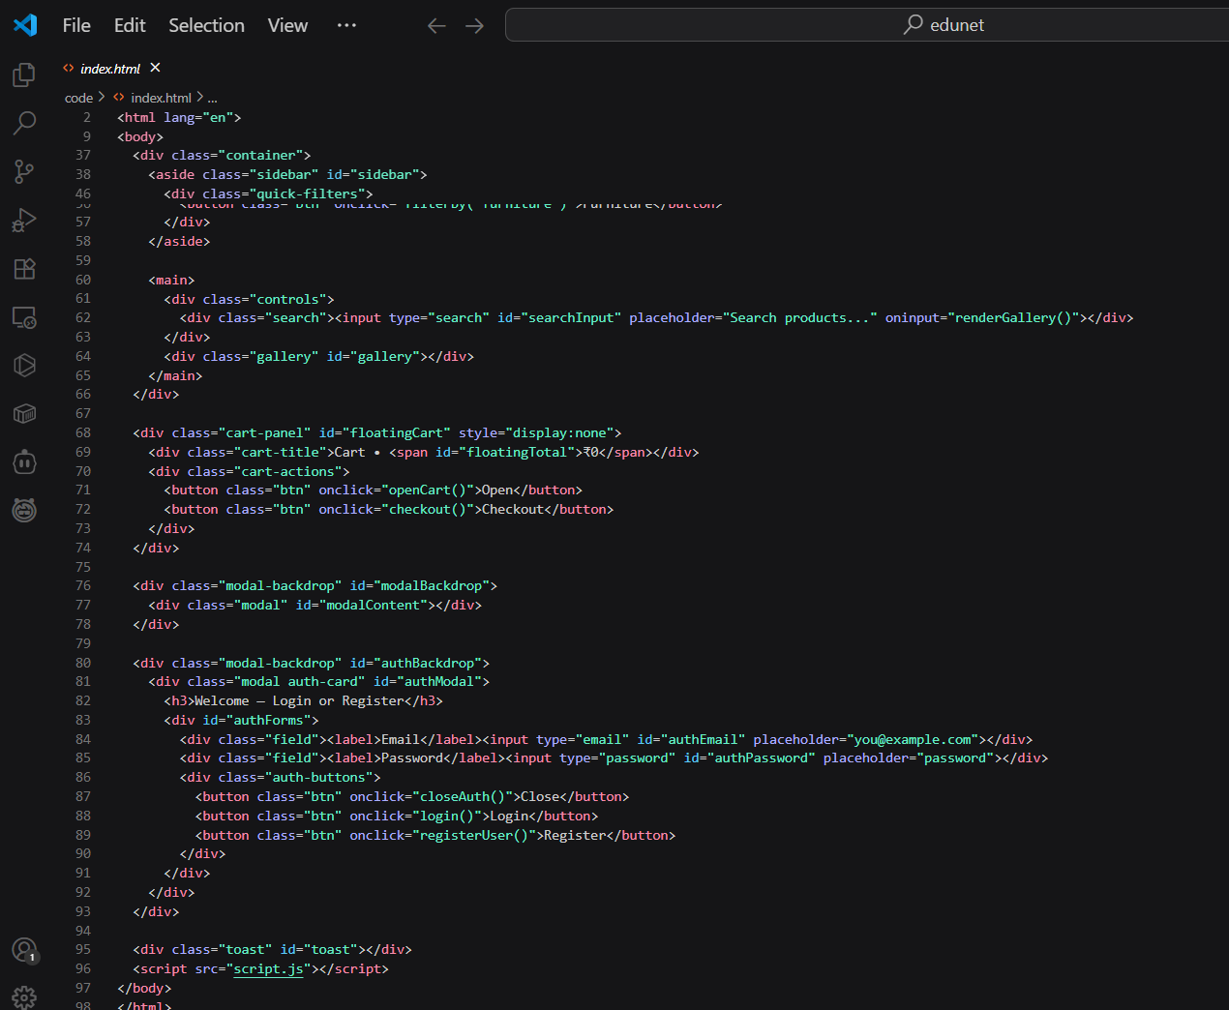
Code (Index.html):

Slide 21
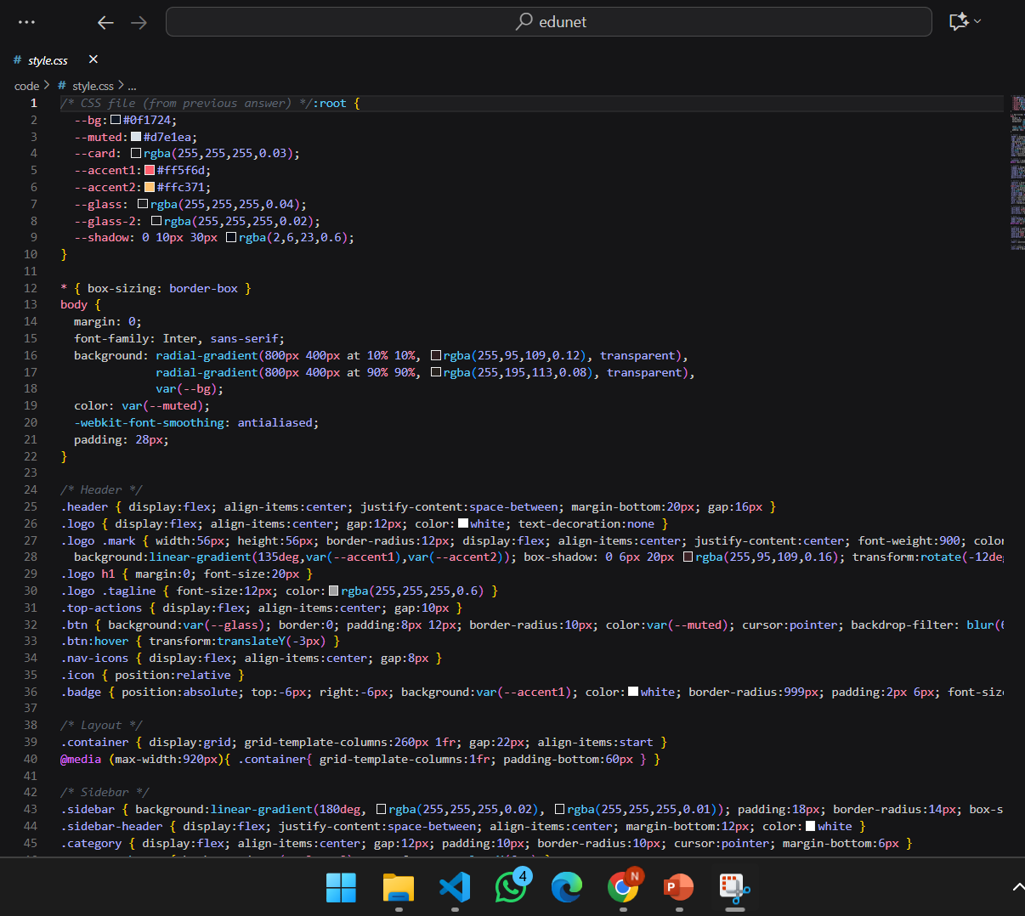
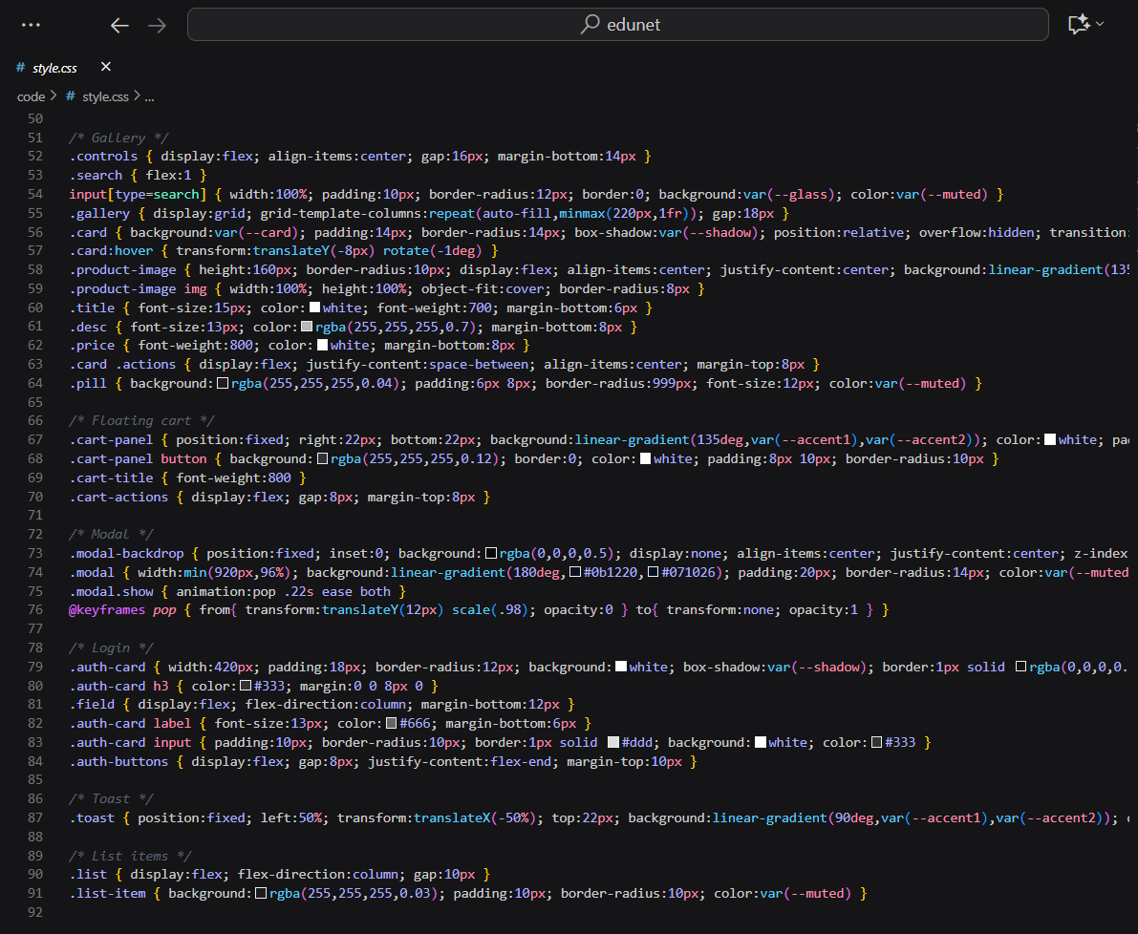
Style.css

Slide 22
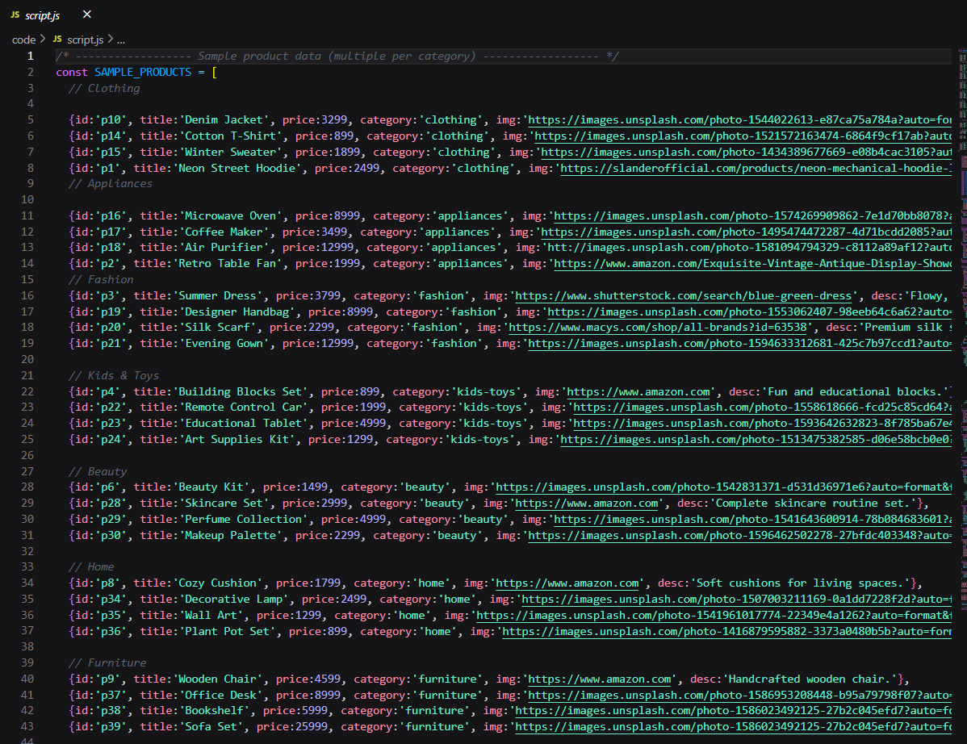
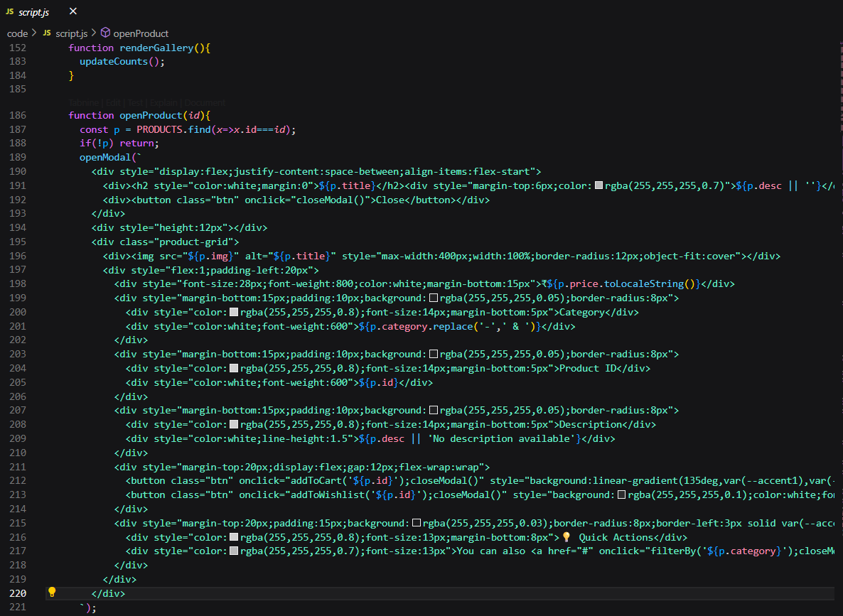
Script.js

Slide 23
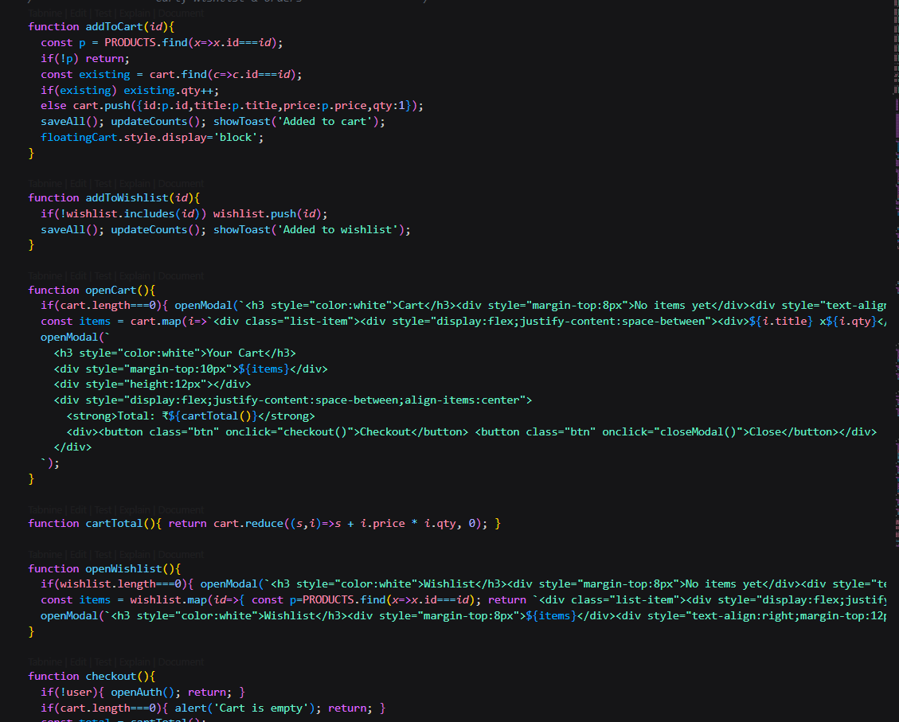
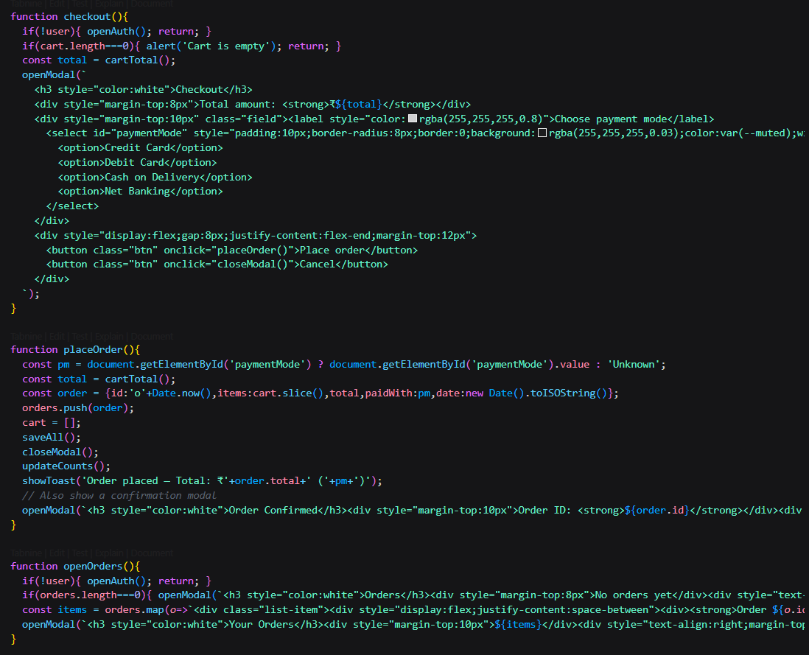

Slide 24
GITHUB AND DEPLOYMNET LINK
Attach your Github Link :
https://github.com/nallamharini/EDUNET-INTERNSHIP--IBM
Deployment link:
https://edunet-internship-ibm.onrender.com

Slide 25
Conclusion
A static website provides small businesses with a cost-effective way to establish an online presence without the high expenses of complex e-commerce platforms. By eliminating dependency on systems like Shopify or Magento, businesses can focus on showcasing their products and services through a simple, easy-to-maintain site that avoids recurring costs and technical overhead. At the same time, modern static sites can deliver an engaging and interactive customer experience through responsive designs, animations, galleries, and contact forms, ensuring fast performance and user-friendly navigation. This combination of affordability, simplicity, and interactivity makes static websites an ideal solution for small businesses looking to build visibility and connect with their customers online.

Slide 26
Future scope(Optional)
Integration of payment gateways and shopping cart functionality to enable full e-commerce capabilities.
Addition of a content management system (CMS) for easy updates to products, prices, and offers without technical expertise.
Implementation of AI-powered chatbots and personalized recommendations to improve customer engagement.
Development of progressive web app (PWA) features for offline access and an app-like mobile experience.
Integration of analytics tools to track customer behavior, sales trends, and optimize marketing strategies.
Expansion to support multi-language and multi-currency features for reaching a wider audience.
Incorporation of SEO optimization and social media boost online visibility and customer reach.

Slide 27
THANK YOU

